Slide 1
Digital Age Libraries and Youth: Learning Labs, Literacy Leaders,
Radical Resources
Oregon Library Association
Children's Services Division
Fall WORKSHOP
October 27, 2012
Notes:
Digital Age The Ito (2010) et al. study iterates that “even youth who do not possess computers and Internet access in the home are participants in a shared culture where new social media, digital media distribution and digital media production are commonplace among peers and in their everyday school contexts” (43) paralleling
Dresang’s proposal that “the impact of the microchip extends beyond direct contact with digital media to influence how one gives, receives, and creates information. The digital environment is ubiquitous; it permeates everyday life” (2005a 179). This is a key concept that libraries have been quick to grasp – youth are ‘growing up digital ‘no matter what their access to new media is.

Slide 2



Dr. Eliza T. Dresang,
Cleary Professor for
Children and Youth Services
J. Elizabeth Mills,
MLIS Candidate and
Cleary Graduate Assistant
Notes:
Warm-up – Liz & Dungeons & Dragons
Me – Coach youth soccer

Slide 3
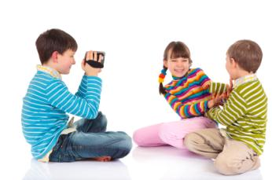
Introduction
Notes:
Are libraries for youth irrelevant in the internet age? According to the latest available statistics, 17,500 public library facilities and 81,900 public school libraries that serve youth in the US. In comparison there are in the same time period an estimated 14,000 McDonalds outlets in the US . ). In public libraries there were 2,.4 million programs for children (attended by 61.6 million children), and 260,000 programs for young adults, attended by 4.4 million teens. Judging by numbers alone, at least in the US, libraries continue to have a significant presence in the lives of youth.

Slide 4

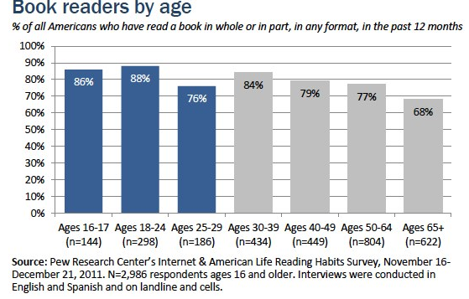
Young Readers’ Library &
Reading Habits

Slide 5

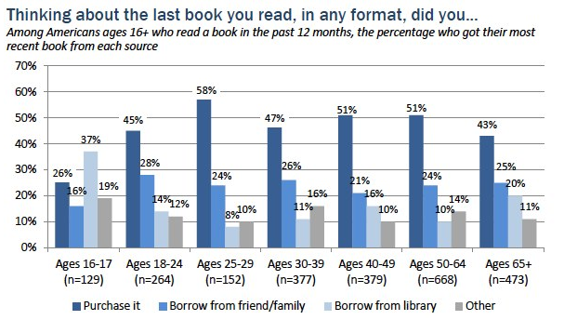
Young Readers’ Library &
Reading Habits
Notes:
But delving beyond these statistics, what has changed about the roles of libraries in children’s and teen’s information behaviour in the Internet-dominated, media-rich participatory culture? How have libraries adapted to the needs, interests, and information -seeking, use, and creating of youth in the digitally saturated environment of the 21st century?

Slide 6

Digital Age Assumptions about Youth
Youth are capable and seeking connections.
The digital environment nurtures youth’s capabilities.
Handheld books offer digital-age connections.
Adults and youth are partners in the digital world.
Notes:
The research reported occurred largely in the US but has lessons applicable to potential roles for libraries wherever digital age youth and libraries connect. Underlying these changes are some assumptions about youth to keep in mind when reflecting on the roles that libraries for youth play in the 21st Century.
ITO: one of the important outcomes of youth participation in many online practices is they have an opportunity to interact with adults who are outside of their usual circle of family and school-based adult relationships”(24). She “argues against the trivialization of children’s media culture and sees it as a site of child-and-youth creativity and social action

Slide 7
21st Century Change #1:
Libraries as Labs for Learning
Labs for Learning
Labs for Learning about Learning
Notes:
What does this mean to you ?
In the 21st century Libraries serve both as partners in research and as laboratories for field testing research conducted elsewhere.
First 21st century change ---
Two compilations of research on Youth Information Behavior were published during the first decade of the 21st century (Chelton and Cool 2004; Chelton and Cool 2007). The 2004 volume focuses on research in school library settings, largely with youth carrying out projects required of them in an instructional context, while the 2007 tome incorporates five chapters on every day, informal information behaviour of youth. No work in either book includes research in public library settings,
so the presence of such studies I”ll talk about today marks a move to greater diversity of setting in the study of youth information behaviour.

Slide 8

Digital teens
Past: good was good
Now: Libraries as partners and laboratories for research
Notes:
For decades not much research focused on youth in libraries, especially not on information behaviour in libraries, and libraries were not much interested in research; everyone knew that libraries were good for youth and that was thaT
That perspective has changed dramatically over the past two plus decades. The digital age and the realization of youth capabilities in relation to new media has brought with it an increased interest in research about youth information behaviour in a library environment from both scholars and library staff.
The attention that researchers are now paying to research in both school and public libraries has promoted the role of libraries as labs for learning about learning and about the information behavior of digital age youth as well as places where young people learn

Slide 9
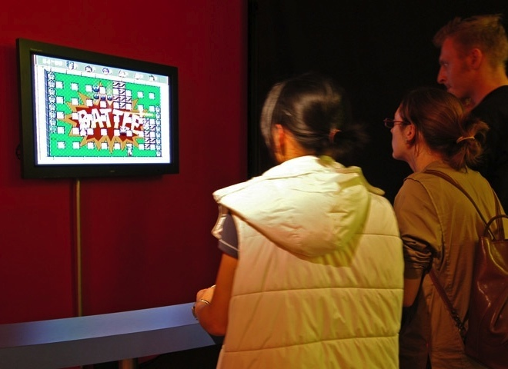
Hanging out, messing around, geeking out (Ito 2010)
Notes:
As Ito explains. . . we move beyond a simple socialization model in which children are passive recipients of dominant and ‘adult’ ideologies and norms, and instead we deploy what Corsaro calls an Interpretive Reproduction model. In this model . . .we seek to give voice to children and youth who. . .have often not been heard (Ito 2010, 23).
The , of a multi-year study of youth use of digital media in and outside of school published in commercial printed and ebook formats, but also free online, with the title Hanging Out, Messing Around, Geeking Out (Ito 2010) is of monumental importance to libraries in defining their role in the information behaviour of youth Both copies are checked out of UW libraries and the PDF link in the citation no longer works.
[STOP] Talk about terms in library setting
‘Hanging out’ has to do with getting together with friends; media is often the connecting device. ‘Messing around’ moves toward a more serious engagement with new media; Messing around can also involve producing or creating. (Ito et al. 2010, 66). The third mode or genre represents the most focused form of informaion behavior. ‘Geeking out’ is “a more serious engagement with media or technology”(

Slide 10

YouMedia:
First MacArthur
IMLS library learning lab
Notes:
So what happens when this research is applied to libraries?
YouMedia , opened in July 2009 in the Harold Washington Library Center of the Chicago Public Library, is the first Library Learning Lab, and a far more detailed and elaborate venue than the ones to follow. Created with expenditures of approximately $1.2 million, the Center has three3 distinct areas: a relaxed Hang Around space for socializing after school; a Mess Around space for both individual and collaborative use of library materials such as games, books and, computers for individual interest pursuit or homework resources.; and a Geek Out space for indepth engagement with digital resources. So far by library staff and users alike, this learning lab is deemed a success by library staff and
Are the 70 or so teens that use this 5500 square- foot space on a typical day really engaged in information behavior? If meeting their interests and needs with library resources is any measure, the answer is definitely yes

Slide 11
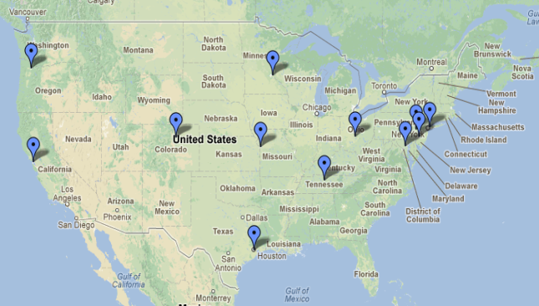
21st century libraries as learning labs
Notes:
The Oregon Museum of Science and Industry in Portland, OR, in partnership with the Multnomah County Library, will convene expert advisors, community advocates, and a teen advisory council in an in-depth planning and design process for the implementation of a hands-on Community Maker Center. Once completed, the space will be a resource youth to gain the 21st century skills needed to participate in a productive civic life.
A Teen Advisory Council will inform and collaborate on plans for the design and operation of the Maker Center. In response to a near 20% drop-out rate in Portland Public Schools, the Maker Center will align with Ninth Grade Counts, an effort to connect youth entering grade nine with the support they need to begin high school on the right track. Local youth will have opportunities to engage in creative activities, be valued as resources, and work with adult role models. Project partners include Ninth Grade Counts, Multnomah Youth Commission, FIRST (mentor-based programs that build science, engineering and technology skills), TechShop and Oregon Mentors.
PARTICIPATION [ what most important?]

Slide 12
Most important finding of first year of You Media
Importance of library staff
Youth as teachers and staff as partners
Notes:
Also instructive is a careful reading of the first-year evaluation, YouMedia: Re-imagining Learning, Literacy and Libraries, conducted by the Consortium on Chicago School Research at the University of Chicago (Austin et al. 2011). One finding of the evaluation research was that the primary duty of both librarians and mentors was building relationships with teens. Until these relationships were built, despite the plethora of digital and traditional materials, teens largely did not move from ‘hanging out.’ In addition, the process of collaboration helped teens learn how to be part of a community, while it simultaneously supported individual growth as teens become educated consumers of each other’s work--keys to successful projects” (34).

Slide 13
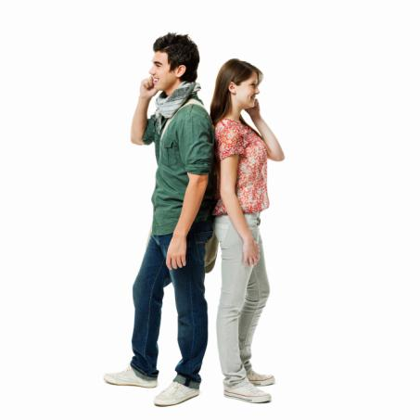
Other library as learning lab projects
YA Spaces (Bernier)
Notes:
In the 21st century there has been an upturn in libraries’ interest in providing YA spaces. However, according to a small research project it appears that accommodating digital age youth information behavior was not a primary outcome (Bernier 2009). One positive finding of this Bernier study was that these libraries recognized the need and desirability for YAs to participate in the planning of the design, individually and in focus groups (2009). A follow-up IMLS-funded research project, 2010 - 2013, is documenting in a systematic manner practices in the design of YA spaces, including the participation of youth in the design process. The investigation includes building relationships with young adults.

Slide 14

Other library as learning lab projects
Independent versus group information seeking (Meyers 2011)
Notes:
Beyond the myriad social networking opportunities, other more formal or structured ways exist in the digital environment for children’s collaborations that facilitate information exchange, and these opportunities can be either peer to peer or intergenerational. A recent study of the efficacy of groups in which students are asked to collaborate in a middle school library setting enhanced what we know about the popularity of this practice among students as well as the efficacy of this mode of information behavior (Meyers 2011). Twenty-first century information- seeking environments often require group work, so knowing the positives and negatives for students of participating in them is essential.
Both supporting and refuting what might be regarded as common knowledge in today’s connected world, the findings indicate that “. . .despite students’ apparent preference for working in groups, this arrangement does not always provide cognitive benefits or improved learning outcomes.” Moreover, Meyers was able to correlate preference as well as positive learning benefits from either social or individual work with specific steps of the Big6 information-seeking/problem solving process.

Slide 15

Other library as learning lab projects
Scratch in Libraries
Notes:
Scratch is a graphic programming language. It was developed by the Lifelong Kindergarten Group at the MIT Media Lab for youth ageds nine to 9–13 to create their own interactive stories, animations, games, music, and art, and to share them online. With the website made public in May 2007, by October 2012 there were 1,2 million registered members, 368,000 project creators, 2.8 million projects uploaded,.
Even the simplest Scratch project requires the entire range of cognitive skills and at each stage the creator is likely to have to seek information to proceed. Where does he or she find it? Young scratchers themselves created a Scratch wiki in December 2008, which in August 2011 had 700 articles all written by youth participants, filled with information (Scratch Wiki 2011).

Slide 16
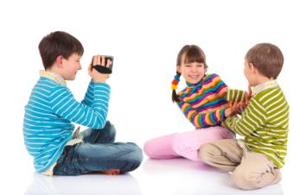
21st Century Change #2:
Libraries Are Literacy Leaders
Notes:
the next role to examine is one that may sound traditional but in many ways it is not because children and research are not, i.e., libraries are literacy leaders.
[BREAK FOR LIZ TO READ SPOOKY WHEELS ON BUS

Slide 17
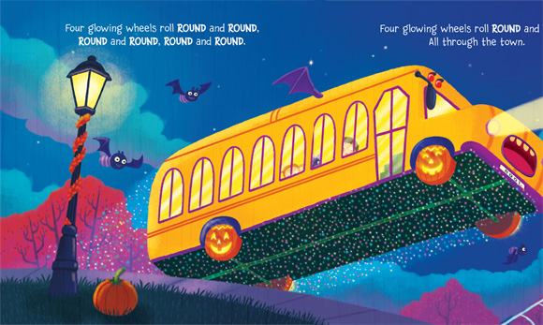
21st Century Change #2:
Libraries Are Literacy Leaders
Notes:
the next role to examine is one that may sound traditional but in many ways it is not because children and research are not, i.e., libraries are literacy leaders.
[BREAK FOR LIZ TO READ SPOOKY WHEELS ON BUS

Slide 18
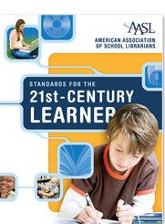


Libraries as literacy promoters
Changing role of librarian
Notes:
The challenge of the 21st century in relation to literacy is its breadth and depth. In the digital environment, literacy must include the ability to “read and understand text in all formats (for examplee.g., picture video, print) and all contexts” (American Association of School Librarians 2007, 2) ‘Text’ and ‘reading’ are used here in the broadest sense of the words to incorporate the ability to decode and understand (as well as to create) all forms and formats of media. To put it simply, as more and more digital media have appeared and been adopted by youth as conveyors of information, the role of libraries has expanded concomitantly to incorporate assisting youth to become literate in their use. Information literacy, the ability to locate, find, use, and create information, is especially considered a responsibility of the school library. The issue of 21st century skills has come to the forefront, and libraries are part of a coalition of educations defining and promoting them, and particularly any dealing with literacies.

Slide 19
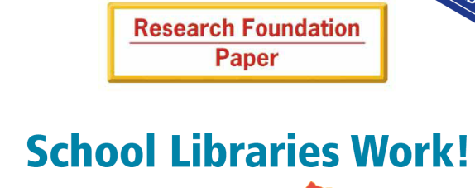
Libraries & achievement

Slide 20

ECRR &
ECRR2
Outcomes and impact
ELSA
VIEWS2
Schools & Early Literacy
Notes:
Is it proper to think of very young children, even babies, as information seekers? As humans with identifiable information behavior? Research conducted at the University of Washington Learning and Brain Sciences Institute (I-LABS) would say a resounding yes, even though they may not have used that terminology. In a TED talk, Patricia Kuhl, co-Director of I-LABS, demonstrates the tremendous amount of information -seeking that babies ageds seven7 to nine9 months do in learning the sounds in their native language (Kuhl 2010). She states that we are embarking on a grand and golden age in exploring children’s brain development, where we can see the development of emotions, how they learn to read, how they solve a math problem and uncover deep truths about what it means to be human
A dramatic decade-long transformation has taken place in the role of public library programs for preschool children in the 21st century due largely to two comprehensive national research reports on early literacy, the 2000 Report of the National Reading Panel (NRP) (National Reading Panel 2000) and the subsequent 2008 Report of the National Early Literacy Panel (National Early Literacy Panel 2008). This change has brought increased nationwide recognition for the role public libraries now play in preparing children to learn to read. on the early literacy principles found to be most closely linked to child success by the NRP meta-analysis of scientific (experimental/control group) research -- phonological awareness – alphabetical knowledge – print awareness – vocabulary – comprehension –print motivation
ECRR2 became available in August 2011 and this time, in addition to the early literacy principles, it provides a great deal of guidance on those activities that give children the opportunity to seek information and practice what they learn, i.e. talking, singing, reading, writing, and playing. VIEWS 2 – IMLS Research

Slide 21
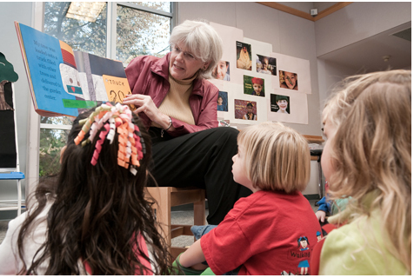
OUTCOMES & IMPACT:
ELSA (Early Literacy Skills Assessment)
VIEWS2 (valuable Initiatives in early literacy that work successfully)
Schools & Early Literacy (State Literacy Council)
Notes:
Is it proper to think of very young children, even babies, as information seekers? As humans with identifiable information behavior? Research conducted at the University of Washington Learning and Brain Sciences Institute (I-LABS) would say a resounding yes, even though they may not have used that terminology. In a TED talk, Patricia Kuhl, co-Director of I-LABS, demonstrates the tremendous amount of information -seeking that babies ageds seven7 to nine9 months do in learning the sounds in their native language (Kuhl 2010). She states that we are embarking on a grand and golden age in exploring children’s brain development, where we can see the development of emotions, how they learn to read, how they solve a math problem and uncover deep truths about what it means to be human
A dramatic decade-long transformation has taken place in the role of public library programs for preschool children in the 21st century due largely to two comprehensive national research reports on early literacy, the 2000 Report of the National Reading Panel (NRP) (National Reading Panel 2000) and the subsequent 2008 Report of the National Early Literacy Panel (National Early Literacy Panel 2008). This change has brought increased nationwide recognition for the role public libraries now play in preparing children to learn to read. on the early literacy principles found to be most closely linked to child success by the NRP meta-analysis of scientific (experimental/control group) research -- phonological awareness – alphabetical knowledge – print awareness – vocabulary – comprehension –print motivation
ECRR2 became available in August 2011 and this time, in addition to the early literacy principles, it provides a great deal of guidance on those activities that give children the opportunity to seek information and practice what they learn, i.e. talking, singing, reading, writing, and playing. VIEWS 2 – IMLS Research

Slide 22
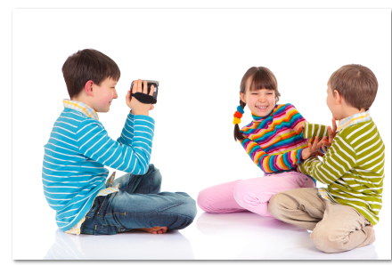
21st Century Change #3:
Radicalizing Resources

Slide 23

21st Century Change #3:
Radicalizing Resources

Slide 24
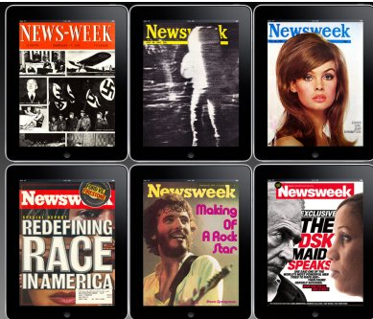
Do libraries need books?
Notes:
In February 2010, the editors of Tthe New York Times felt prompted to pose the question “Do School Libraries Need Books?” It had been a few months since James CaseyTracy, head master of Cushing Academy, a privileged New England School, had announced that the school’s administrators had decided to give away all of the books in their school library, replacing them with ebook readers, large screen televisions, and in place of the reference desk a café and a cappuccino machine (Abel 2009). The Times editors in their “Room for Debate” section had invited five guests, including Mr. Casey Tracy to comment on this question. Mr. Casey Tracy declared the redesign, based on needs of digital- age students, a complete success. A study Joyce Valenza conducted with two classes of students at Springfield Township high school in PA lends insight into how the role of the digital age school library has morphed to meet the needs of digital age users One student more or less summed up how all the students responded to the online services tailor-made to their needs when he said, “It’d be really dumb not to use it. Everything there’s laid out for you”
NEWSWEEK DISAPPEARS

Slide 25
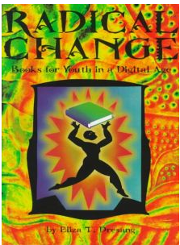
How ‘radical’ are handheld books?
Notes:
In February 2010, the editors of Tthe New York Times felt prompted to pose the question “Do School Libraries Need Books?” It had been a few months since James CaseyTracy, head master of Cushing Academy, a privileged New England School, had announced that the school’s administrators had decided to give away all of the books in their school library, replacing them with ebook readers, large screen televisions, and in place of the reference desk a café and a cappuccino machine (Abel 2009). The Times editors in their “Room for Debate” section had invited five guests, including Mr. Casey Tracy to comment on this question. Mr. Casey Tracy declared the redesign, based on needs of digital- age students, a complete success. A study Joyce Valenza conducted with two classes of students at Springfield Township high school in PA lends insight into how the role of the digital age school library has morphed to meet the needs of digital age users One student more or less summed up how all the students responded to the online services tailor-made to their needs when he said, “It’d be really dumb not to use it. Everything there’s laid out for you”
NEWSWEEK DISAPPEARS

Slide 26

What is a book?
Notes:
This question is perhaps the most radicalizing aspect of digital access. It is likely that even a decade ago few librarians thought they would have to ask not only what a good book is, but actually what is a book? This has now become an issue as libraries struggle to maintain maximum access for children to books but are uncertain when an online book with animated figures, sound, and moving objects, ceases to be a book at all. And, also, librarians are faced with a cacophony of conflicting opinions about whether those that are deemed books promote or hinder reading.
Research is only beginning to appear and is sure to report conflicting results, but in one small randomized study conducted by a reading coach in University City, OhioMissouri, children reading Tumblebook ebooks scored 23 points ahead of those in the control group three months into the study and were able to exit the problem in five months, two months ahead of the children in the control group (Guernsey 2011). According to the annual School Library Journal technology survey, in 2011 a majority of high school libraries had purchased ebooks (64 percent%), while only 29 percent% of elementary school libraries had invested in this format. And what about the young information seekers? Teens are somewhat on the fence but many find the format cool (Springen 2011). The major barrier now lies neither with the libraries nor the youth, but with the policies of publishers and distributors,

Slide 27

A digital library for the world’s children
Notes:
Long before the proliferation of formats and styles, the International Children’s Digital Library (ICDL), the first and only free digital library for children, had set as one of its goals international access for children. Libraries have it for free with none of the hassles mentioned above – and it now comes with apps for iphone, ipod, and ipad.
Surprising to some is the fact that a digital library for youth with ebooks, readers amazing resources has been around since November 2002 at the University of Maryland . Its goal is to represent all cultures and languages so that no child is denied the right to read in his or her mother tongue. In 2012, the ICDL collection includes 4643 books in 61 languages with a goal to have 10,000 books in at least 100 languages across 228 different countries.
University of Maryland has found children in many countries enjoy and appreciate this library.

Slide 28

What is a book?
Notes:
This question is perhaps the most radicalizing aspect of digital access. It is likely that even a decade ago few librarians thought they would have to ask not only what a good book is, but actually what is a book? This has now become an issue as libraries struggle to maintain maximum access for children to books but are uncertain when an online book with animated figures, sound, and moving objects, ceases to be a book at all. And, also, librarians are faced with a cacophony of conflicting opinions about whether those that are deemed books promote or hinder reading.
Research is only beginning to appear and is sure to report conflicting results, but in one small randomized study conducted by a reading coach in University City, OhioMissouri, children reading Tumblebook ebooks scored 23 points ahead of those in the control group three months into the study and were able to exit the problem in five months, two months ahead of the children in the control group (Guernsey 2011). According to the annual School Library Journal technology survey, in 2011 a majority of high school libraries had purchased ebooks (64 percent%), while only 29 percent% of elementary school libraries had invested in this format. And what about the young information seekers? Teens are somewhat on the fence but many find the format cool (Springen 2011). The major barrier now lies neither with the libraries nor the youth, but with the policies of publishers and distributors,

Slide 29
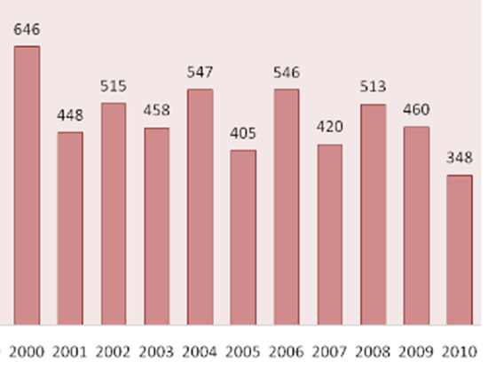
New frontiers to defend access for youth
Notes:
One other way in which libraries’ roles have adapted to the Internet-dominated, media-rich, participatory culture is in protecting children’s right to access information in an arena that is even more frightening to some adult users than books are or ever were. In the past two decades children’s print books have expanded to contain topics previously thought taboo (Dresang 1999). To the surprise of some, however, documented book challenges have declined during the 21st century to date, a decrease of 47 percent% between the 2000 and 2010 according to the website of the ALA Office of Intellectual Freedom (ALA 2011) as shown in Figure 1.
On the other hand, the Internet has brought a depth and breadth of material previously unavailable, forcing libraries to be mindful constantly of protecting access for youth, protecting their privacy, and at the same time remaining within the boundaries of the law. Filters are required on all school computers in order for schools to receive federal funding.” Astute digital age librarians adjust the settings to allow the greatest access legally possible. In public libraries only one computer has to be filtered. The ALA has a number of interpretations of the Library Bills of Rights, underscoring protecting the right of youth to free speech and access. The June 2011 issue of the Voice of Youth Advocates, a journal for those interested in youth and their access to libraries, contains articles from librarians, authors and others. Even with the radicalizing of both offline and online resources, stalwart librarians who believe in the rights of youth take on this challenge and make it their duty to stay informed. It is part of believing that children are capable.

Slide 30
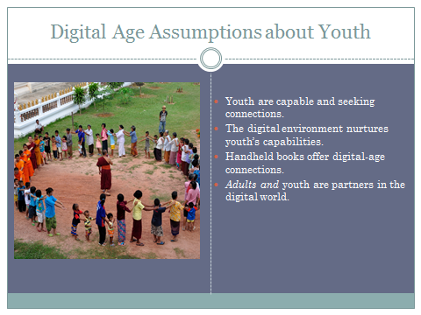
Conclusion
Notes:
Libraries have changed but they are anything but disappearing
How have they changed for youth in the 21st century?
They have become learning labs as well as labs for learning
They have become literacy leaders
They have taken on radicalizing of resources.

