Slide 1

Beverly Cleary Children’s Choice Award
2018-2019 https://ola.memberclicks.net/bccca-home
Oregon Library Association

Slide 2

BCCCA
The Beverly Cleary Children's Choice Award (BCCCA) sponsored by OASL (formerly OEMA) is named in honor of Beverly Cleary, the Oregon born children's book author. Children of all ages may vote each spring for their favorite title from the list of nominated books. Nominations include books targeted to the reading ability of 2nd and 3rd graders or transitional readers.

Slide 3
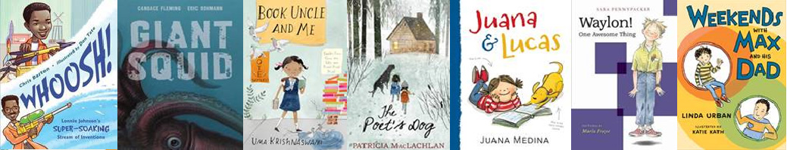
Which one of these seven 2018 -2019 BCCCA Nominees will win?

Slide 4

Whoosh! Lonnie Johnson’s
Super-soaking Stream of Inventions
By Chris Barton
Trying to create a new cooling system for refrigerators and air conditioners, impressive inventor Lonnie Johnson instead created the mechanics for the iconic toy, the Super Soaker.

Slide 5
Whoosh! Lonnie Johnson’s Super-Soaking Stream of Inventions
Resources
  Video Trailer from Texas Bluebonnet Award 2018
  Meet the Author
  Book Reading with Chris Barton
  Author’s Website
  Illustrator’s Website
  Discussion points, activities, and writing prompts
  Extension Activities from AASL Blog
  Readers Theater Script from Texas Bluebonnet Award 2018
  Audio Interview with Chris Barton
  Teaching ideas from Texas Bluebonnet Award 2018

Slide 6
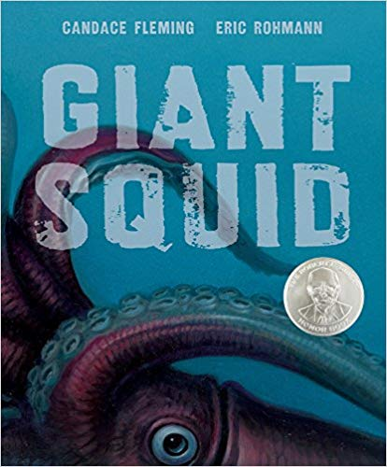
Giant Squid
By Candace Fleming
The giant squid is one of the most elusive creatures in the world. As large as whales, they hide beyond reach deep within the sea, forcing scientists to piece together their story from those clues they leave behind.

Slide 7
Giant Squid
Resources
  Lesson Plans
  Author’s Website
  Illustrator’s Website

Slide 8

Book Uncle and Me
By Uma Krishnaswami
Set in India, nine-year-old Yasmin intends to read a book a day for the rest of her life. Book Uncle, who runs a free lending library on the street corner, always has the perfect book for her. But when Book Uncle seems to be in trouble, Yasmin has to take her nose out of her book and do something.

Slide 9
Book Uncle and Me
Lesson Plans
Author’s Website

Slide 10
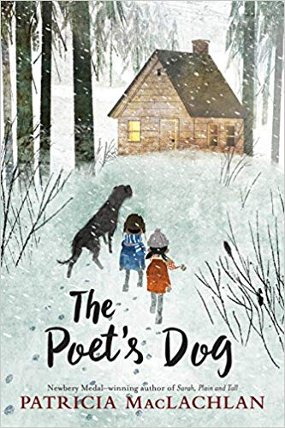
The Poet’s Dog
By Patricia MacLachlan
Teddy is a gifted dog. Raised in a cabin by a poet named Sylvan, he grew up listening to sonnets read aloud and the comforting clicking of a keyboard. Although Teddy understands words, Sylvan always told him there are only two kinds of people in the world who can hear Teddy speak: poets and children. Then one day Teddy learns that Sylvan was right. When Teddy finds Nickel and Flora trapped in a snowstorm, he tells them that he will bring them home—and they understand.

Slide 11
The Poet’s Dog
Resources
  Harper Collin’s Website
  Houghton Mifflin’s Website
  Scholastic’s Website
  Harper Collin’s Excerpt of The Poet’s Dog

Slide 12
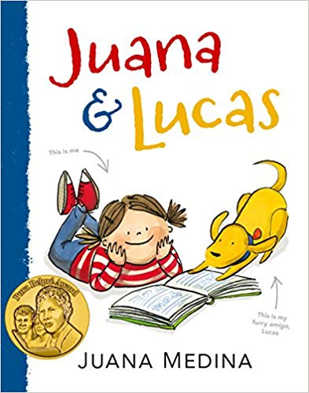
Juana & Lucas
By Juana Medina
Juana loves many things — drawing, eating Brussels sprouts, living in Bogotá, Colombia, and especially her dog, Lucas, the best amigo ever. She does not love wearing her itchy school uniform, solving math problems, or going to dance class. And she especially does not love learning the English. Why is it so important to learn a language that makes so little sense?

Slide 13
Juana & Lucas
Resources
  Lesson Plans
  Educator Links
  (Including Spanish/English Flashcards)
  Author’s Website
  Discussion Questions

Slide 14

Waylon! One Awesome Thing
By Sara Pennypacker
It's impossible for Waylon to concentrate on his inventions when he's experiencing his own personal Big Bang. Arlo Brody is dividing the fourth grade boys into two groups. Waylon would rather be friends with everyone. Well, everyone except the scary new kid, Baxter Boylen.

Slide 15
Waylon! One Awesome Thing
Resources
  Author’s Website
  Illustrator’s Website
  Activity Kit
  Discussion Guide

Slide 16

Weekends with Max and His Dad
By Linda Urban
Third grader Max and his dad love their weekends together. Weekends mean pancakes, pizza, spy games, dog-walking, school projects, and surprising neighbors! Every weekend presents a small adventure as Max gets to know his dad’s new neighborhood—and learns some new ways of thinking about home.

Slide 17
Weekend’s With Max and His Dad
Resources
  Illustrator’s Website
  Publisher’s Website of the Author and Illustrator

Slide 18
BCCCA Voting-
To vote for the BCCCA winner, children must read or listen to at least 2 of the nominated titles.
After tallying the student ballots, librarians or teachers need to enter the final voting tallies using the Online Ballot available on the BCCCA website from March 15th – April 10, 2019. Students do not enter their votes online.
Links for the Student paper ballots and adult online ballot https://ola.memberclicks.net/bccca-how-to-vote
Every vote counts! The winning title will be announced on April 12th, Beverly Cleary’s birthday.

Slide 19
For BCCCA bookmarks and flyer
To download free BCCCA bookmarks, spine labels and a flyer go to:
https://ola.memberclicks.net/bccca-support-materials
Thank you for promoting and participating in the BCCCA contest!
A huge round of applause to Mrs. Jan Jones, BCCCA Committee member, for creating this powerpoint. Web links provided by Mrs. Libby Hamler-Dupras, BCCCA Chair.

