Slide 1
Beverly Cleary Children’s Choice Award 2019-2020
Sponsored by the Oregon Association of School Libraries and Oregon Library Association

Slide 2
BCCCA
The Beverly Cleary Children's Choice Award (BCCCA) sponsored by OASL (formerly OEMA) is named in honor of Beverly Cleary, the Oregon born children's book author. Children of all ages may vote each spring for their favorite title from the list of nominated books. Nominations include books targeted to the reading ability of 2nd and 3rd graders or transitional readers.

Slide 3
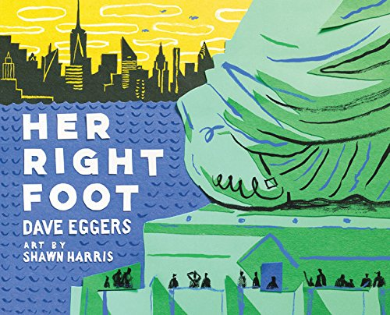
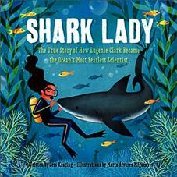
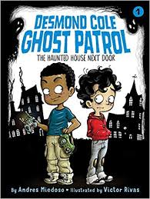
Seven Nominees

Slide 4
Zoey and Sassafras #1 Dragons and Marshmallows By Asia Citro
In the first book of this series, Zoey discovers a glowing photo and learns an amazing secret. Injured magical animals come to their backyard barn for help! When a sick baby dragon appears, it’s up to Zoey and Sassafras to figure out what’s wrong. Will they be able to help little Marshmallow before it’s too late?

Slide 5
Zoey and Sassafras #1 Dragons and Marshmallows
Resources
Zoey and Sassafras Webpage
Free Book Study from Teacher Pay Teacher

Slide 6
Her Right Foot By Dave Eggers
In this fascinating and fun take on nonfiction for kids, Dave Eggers and Shawn Harris investigate a seemingly small trait of America's most emblematic statue. What they find is about more than history, more than art. What they find in the Statue of Liberty's right foot is the powerful message of acceptance that is essential of an entire country's creation.

Slide 7
Her Right Foot
Resources
Her Right Foot Webpage
Teacher Guide
RIF – Classroom activities

Slide 8
Jasmine Toguchi, Mochi Queen By Debbi Michiko Florence
Eight-year-old Jasmine Toguchi is a flamingo fan, tree climber, and top-notch mess-maker!
She's also tired of her big sister, Sophie, always getting to do things first. For once, Jasmine wishes SHE could do something before Sophie―something special, something different. The New Year approaches, and as the Toguchi family gathers in Los Angeles to celebrate, Jasmine is jealous that her sister gets to help roll mochi balls by hand with the women. Her mom says that Jasmine is still too young to join in, so she hatches a plan to help the men pound the mochi rice instead. Surely her sister has never done THAT before.
But pounding mochi is traditionally reserved for boys. And the mochi hammer is heavier than it looks. Can Jasmine build her case and her mochi-making muscles in time for New Year's Day?

Slide 9
Jasmine Toguchi, Mochi Queen
Resources
Author Webpage
Book Companion

Slide 10
Beatrice Zinker, Upside Down Thinker
By Shelley Johannes
Beatrice does her best thinking upside down.
Hanging from trees by her knees, doing handstands…for Beatrice Zinker, upside down works every time. She was definitely upside down when she and her best friend, Lenny, agreed to wear matching ninja suits on the first day of third grade. But when Beatrice shows up at school dressed in black, Lenny arrives with a cool new outfit and a cool new friend. Even worse, she seems to have forgotten all about the top-secret operation they planned!
Can Beatrice use her topsy-turvy way of thinking to save the mission, mend their friendship, and flip things sunny-side up?

Slide 11
Beatrice Zinker, Upside Down Thinker
Resources
Author Webpage
Author Interview

Slide 12
Shark Lady: The True Story of How Eugenie Clark Became the Ocean’s Most Fearless Scientist
By Jess Keating
Eugenie Clark fell in love with sharks from the first moment she saw them at the aquarium. She couldn’t imagine anything more exciting than studying these graceful creatures. But Eugenie quickly discovered that many people believed sharks to be ugly and scary and they didn’t think women should be scientists.
Determined to prove them wrong, Eugenie devoted her life to learning about sharks. She earned the name Shark Lady with her many discoveries about these beautiful creatures. Through her accomplishments, she taught the world that sharks should be admired, not feared, and that women can do anything they set their minds to.

Slide 13
Shark Lady: The True Story of How Eugenie Clark Became the Ocean’s Most Fearless Scientist
Resources
Author webpage

Slide 14
Desmond Cole Ghost Patrol #1
The Haunted House Next Door
By Andres Miedoso
Meet Desmond Cole! A fearless eight-year-old who runs his own ghost patrol, looking for ghosts, monsters, and mischief makers everywhere. Oh, and he just so happens to be my new best friend…and thank goodness! Because I am afraid of everything.
Welcome to Kersville, a town with a spooky history and a collection of ghosts and spirits who are major mischief makers. Most kids spend their days without ever seeing or dealing with a ghost, but some kids get stuck with a haunt. When that happens, they call Desmond Cole Ghost Patrol. Desmond is the hall monitor of ghosts and monsters. There’s no job too spooky, icky, or risky for Desmond.
I’m not like that at all. My name’s Andres Miedoso. I’m Desmond’s best friend. We do everything together…including catch ghosts. seems cool, right? There’s only on problem: I’m afraid of everything.

Slide 15
Desmond Cole Ghost Patrol, #1
The Haunted House Next Door
Resources
About the Author

Slide 16
Princess Cora and the Crocodile
By Laura Amy Schlitz
Illustrated by Brian Floca
Princess Cora is sick of boring lessons. She’s sick of running in circles around the dungeon gym. She’s sick, sick, sick of taking three baths a day. And her parents won’t let her have a dog. But when she writes to her fairy godmother for help, she doesn’t expect that help to come in the form of a crocodile—a crocodile who does not behave properly.

Slide 17
Princess Cora and the Crocodile
Resources
Illustrator’s Webpage

Slide 18
BCCCA Voting
To vote for the BCCCA winner, children must read or listen to at least 2 of the nominated titles.
After tallying the student ballots, librarians or teachers need to enter the final voting tallies using the Online Ballot available on the BCCCA website from March 15th – April 10, 2020. Students do not enter their votes online.
Links for the Student paper ballots and adult online ballot
https://ola.memberclicks.net/bccca-how-to-vote
Every vote counts! The winning title will be announced on
April 12th, Beverly Cleary’s birthday.

Slide 19
BCCCA Resources
Download free BCCCA
bookmarks, spine labels and a flyer here:
https://ola.memberclicks.net/bccca-support-materials
Thank you for promoting and participating in the BCCCA contest!
Thank you Jan Jones for creating this powerpoint.

